Slide 1
Claims Settlement Quality Scoring
By Gopalakrishnan Kumar, MTech IIT-Bombay,
Freelance Data Science Consultant
LinkedIn: Profile Link : https://www.linkedin.com/in/gopalakrishnankumar-a73301110/
Github:https://github.com/Gopal21236/
Kaggle URL- https://www.kaggle.com/gopalkk2

Slide 2
Google Colab URL
https://colab.research.google.com/drive/1fu7jaSLGfkO8mk8lfXAbQ6hCaH7MC-hx?usp=sharing

Slide 3
Executive Summary
Efficient and high-quality claim settlement is critical for insurance companies to maintain customer trust, regulatory compliance, and operational profitability. However, inconsistent processing time, repeated rework, fraud exposure, and poor customer satisfaction often reduce settlement effectiveness.
This project introduces a multi-factor Claims Settlement Quality Scoring Framework that objectively measures settlement performance using operational, risk, and customer-centric metrics.
The model standardizes claim evaluation and enables performance benchmarking across branches, teams, and claim types.

Slide 4
Business Problem
Insurance companies face challenges such as:
Delayed claim processing
High rework frequency
Fraud leakage
Poor customer satisfaction ratings
Lack of standardized quality measurement
Without a measurable quality index, settlement performance remains subjective and difficult to optimize.

Slide 5
Project Objectives
The primary objectives are:
Develop a weighted settlement quality score
Quantify operational efficiency
Measure fraud impact on quality
Integrate customer satisfaction into performance scoring
Provide data-driven visualization insights
Enable performance benchmarking

Slide 6
Data Overview
The simulated dataset includes:
Processing Time (Days)
Rework Count
Fraud Flag (Yes/No)
Customer Rating (1–5)
Derived fields:
Time Score (normalized efficiency metric)
Rework Score (process accuracy metric)
Fraud Score (risk discipline metric)
Customer Score (service quality metric)
Final Settlement Quality Score

Slide 7
Scoring Methodology
5.1 Normalization Logic
To ensure comparability:
Lower processing time → Higher Time Score
Lower rework → Higher Rework Score
No fraud → Full Fraud Score
Higher customer rating → Higher Customer Score

Slide 8
Scoring Methodology
5.2 Weighted Model
Final Settlement Quality Score is calculated as:
Processing Efficiency → 30%
Rework Control → 25%
Fraud Discipline → 20%
Customer Satisfaction → 25%
This ensures a balanced operational-risk-customer framework.

Slide 9
Scoring Methodology
5.3 Quality Categorization
Scores are segmented into:
Low Quality (0–0.5)
Medium Quality (0.5–0.75)
High Quality (0.75–1.0)
This enables clear managerial reporting.

Slide 10
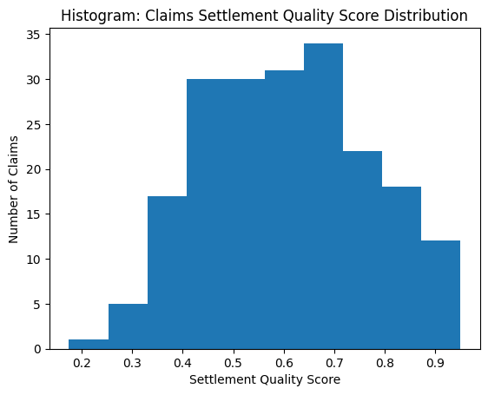
Data Visualization

Slide 11
Visualization & Analytics
6.1 Histogram – Quality Score Distribution
Purpose:
Displays spread of overall settlement quality scores.
Insights:
Majority of claims fall within medium-to-high quality range
Low-score outliers indicate operational inefficiencies
Business Value:
Helps identify SLA risk areas.

Slide 12
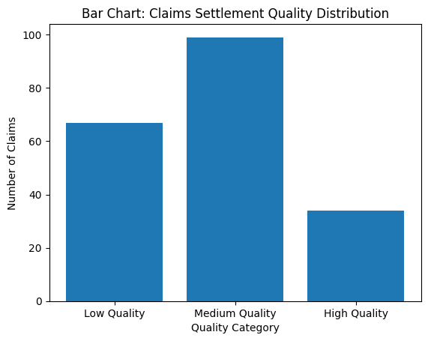
Data Visualization

Slide 13
Visualization & Analytics
6.2 Bar Chart – Quality Category Distribution
Purpose:
Shows volume of Low, Medium, and High Quality settlements.
Insights:
Medium Quality dominates
High Quality represents operational excellence
Low Quality indicates improvement areas
Business Value:
Supports team performance benchmarking

Slide 14
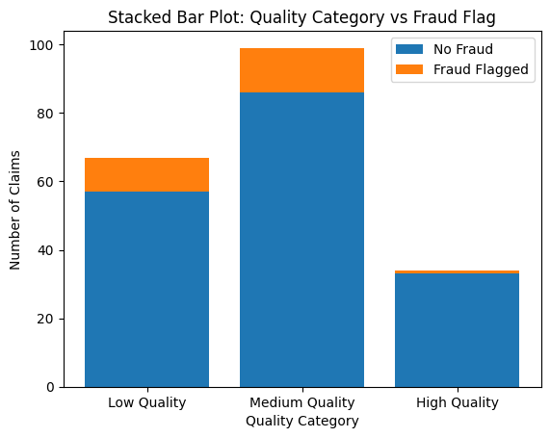
Data Visualization

Slide 15
Visualization & Analytics
6.3 Stacked Bar Chart – Quality vs Fraud
Purpose:
Breaks down fraud presence across quality categories.
Insights:
Fraud cases concentrate in Low Quality settlements
High Quality settlements show minimal fraud impact
Business Value:
Establishes direct relationship between process discipline and fraud control.

Slide 16

Data Visualization

Slide 17
Visualization & Analytics
6.4 Combined Stacked Bar Chart – Executive Dashboard View
Purpose:
Displays total claim volume per quality category with fraud composition.
Insights:
Clear fraud-risk concentration in low-quality group
Medium Quality drives operational workload
High Quality represents best-practice settlement processes
Business Value:
Board-level performance monitoring.

Slide 18
Key Insights
Settlement quality strongly correlates with fraud exposure
Rework frequency significantly reduces overall quality score
Customer satisfaction improves when processing time decreases
High-quality settlements show operational consistency
Low-quality clusters signal process breakdown

Slide 19
Strategic Business Impact
Implementing a Quality Scoring Framework enables:
Standardized performance measurement
Early fraud-risk detection
Reduced claim leakage
Improved customer retention
Data-driven operational governance
Branch/team ranking capability

Slide 20
Operational Benefits
Faster SLA adherence
Reduced manual rework cost
Improved customer trust
Risk-adjusted settlement control
Transparent audit mechanism

Slide 21
Limitations
Simulated dataset
Static weight assignments
No predictive ML enhancement
No real-time integration

Slide 22
Future Enhancements
Machine Learning quality prediction
Dynamic weight optimization
Real-time settlement dashboard
Branch-level KPI tracking
Fraud anomaly detection integration

Slide 23
Conclusion
Claims Settlement Quality Scoring transforms subjective claim evaluation into a measurable, analytics-driven framework. By integrating operational efficiency, fraud discipline, and customer satisfaction into a unified score, insurers can significantly enhance governance, performance benchmarking, and customer experience.
This project demonstrates how quantitative quality measurement drives strategic improvement in claims operations.

